Slide 1
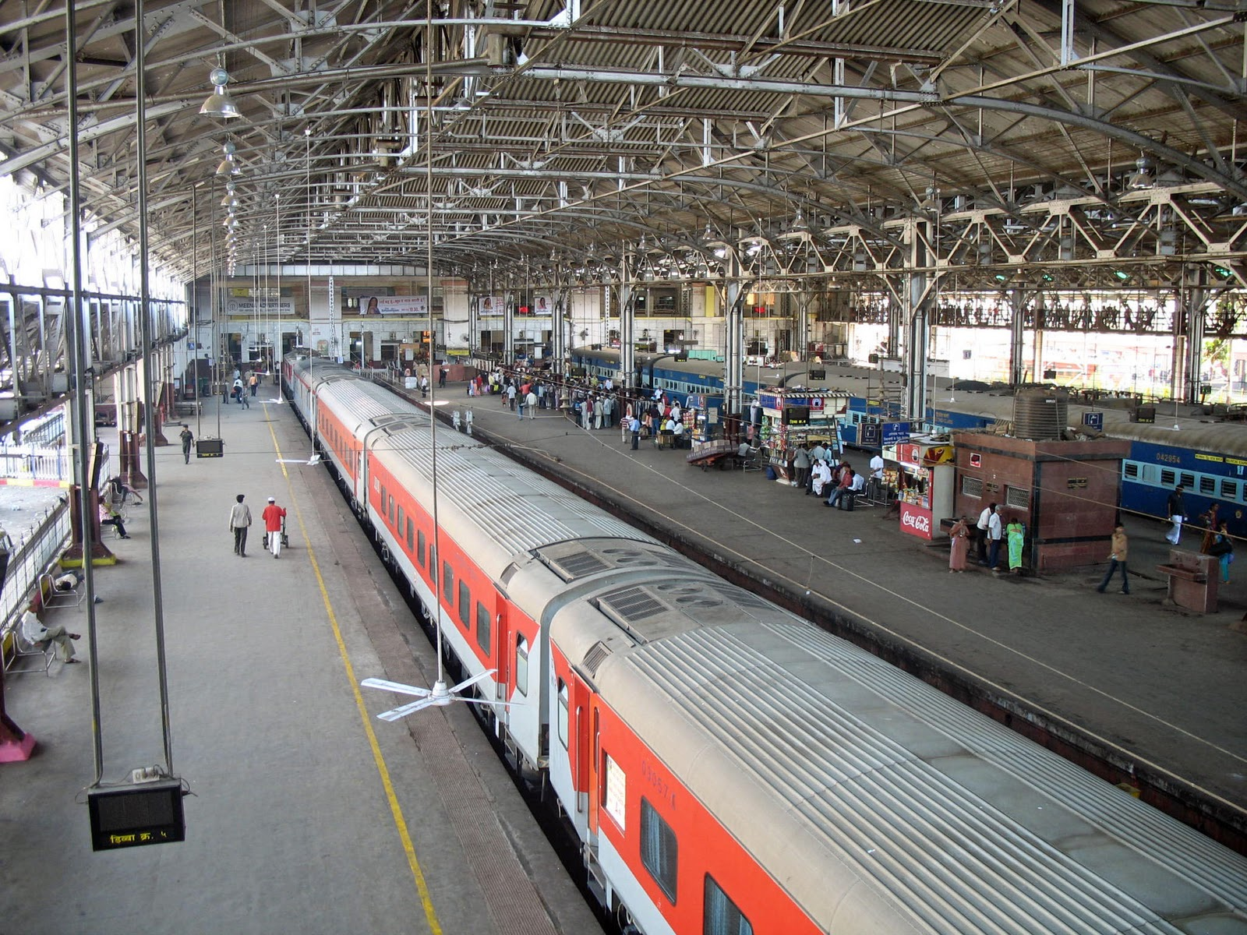
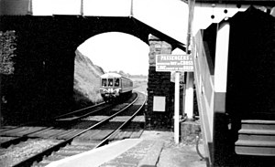
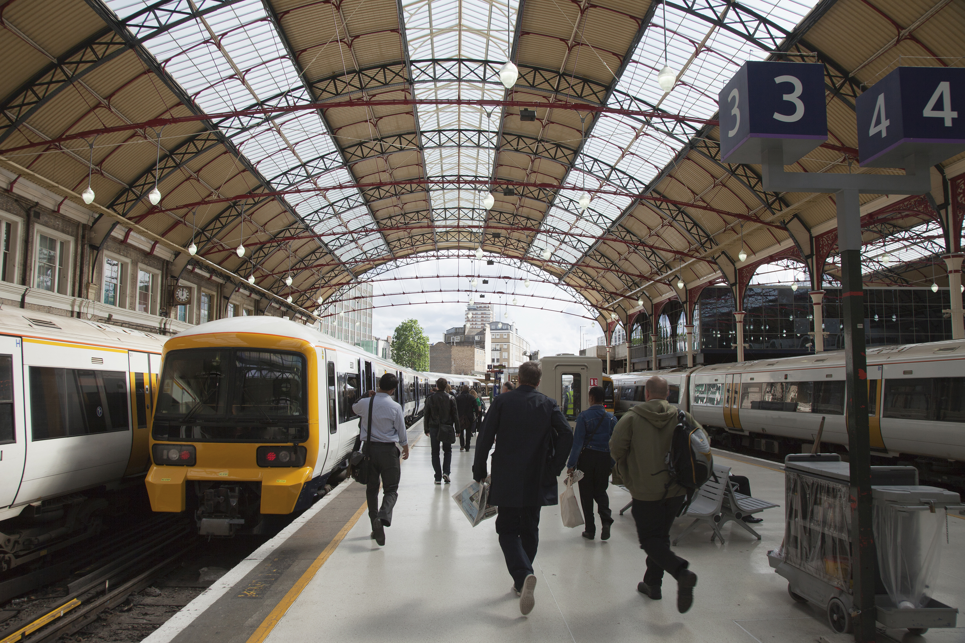
TRACS
Towards Restoring a Caerleon Station

Slide 2
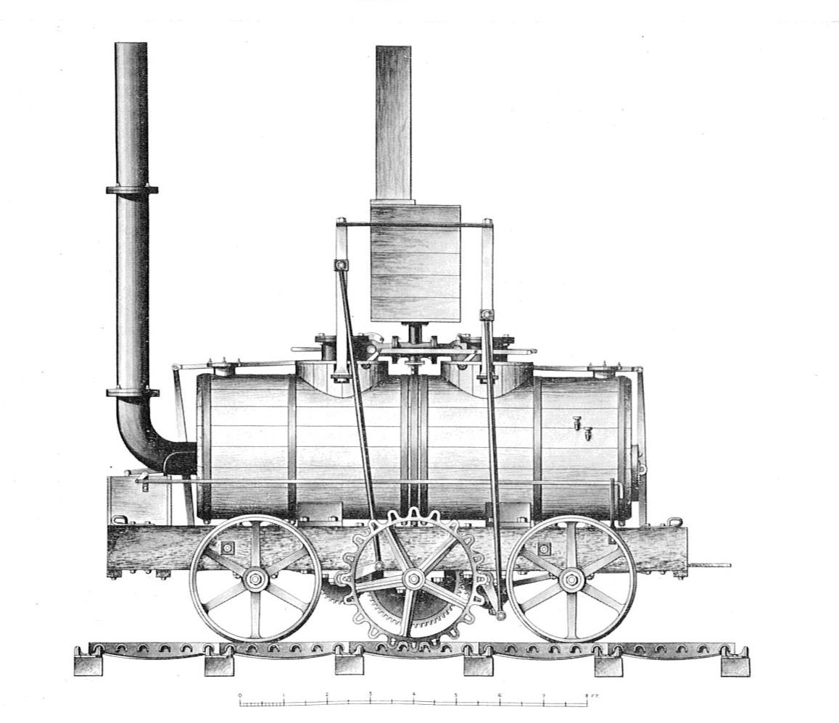
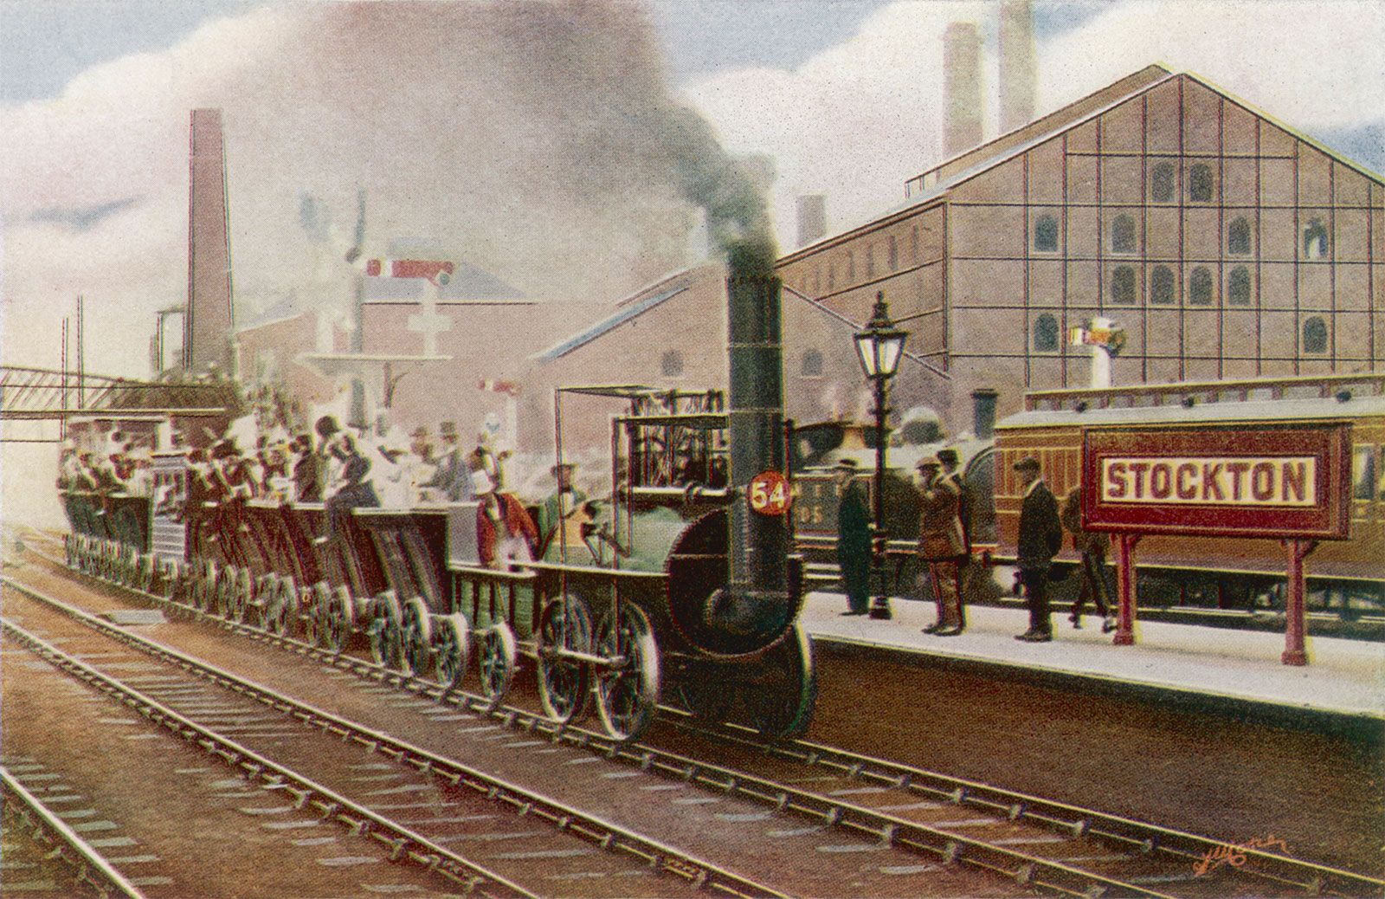
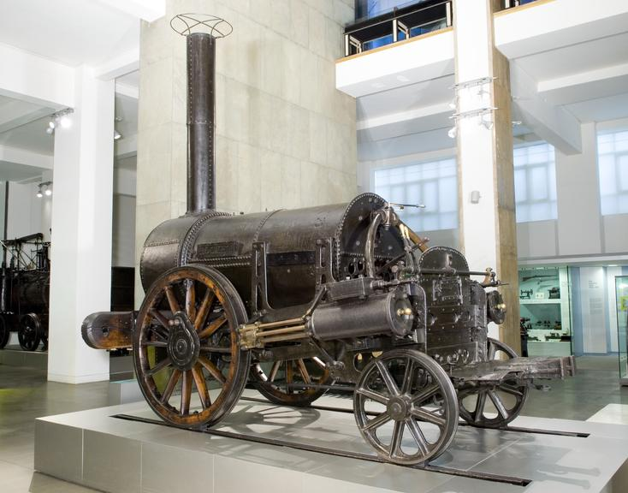
The first full-scale working railway steam locomotive was built in the United Kingdom in 1804 by Richard Trevithick, a British engineer born in Cornwall. This used high-pressure steam to drive the engine by one power stroke. The transmission system employed a large flywheel to even out the action of the piston rod.

Slide 3
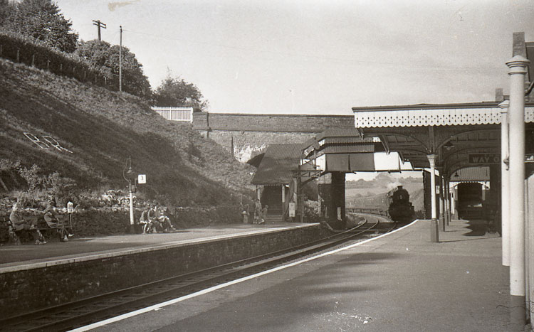
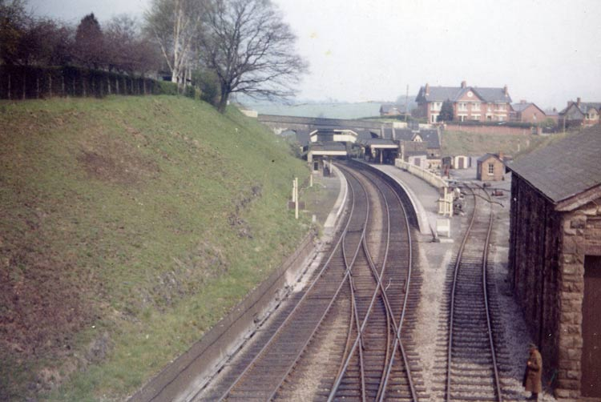
Caerleon Station Before Closure

Slide 4
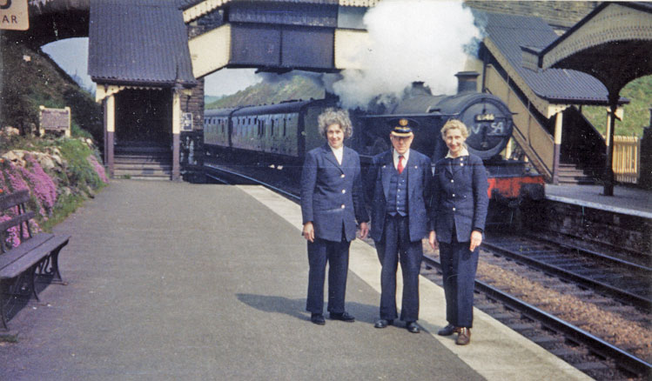
April 1962, shortly before closure, and the staff pose for posterity. Passing behind them is a Manchester to Plymouth train

Slide 5
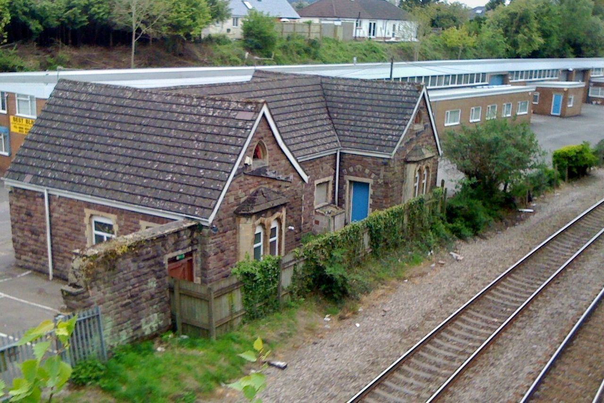
Caerleon Station Today

Slide 6

https://stemdatagame.nrdigital.co/

Slide 7


